Slide 1












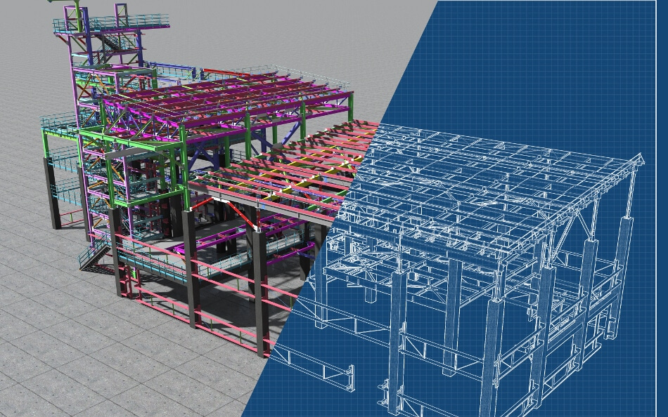

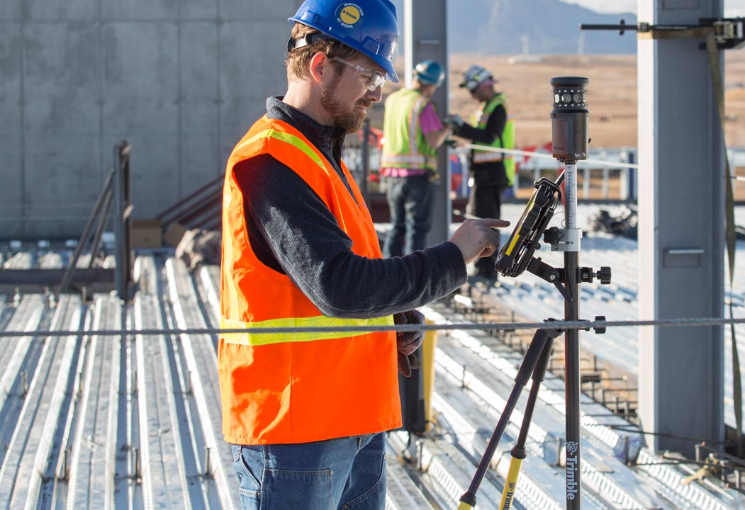


Trusted and Responsible Artificial Intelligence (AI) in Construction Sector: Status and Challenges
Mr. Aaron Guo Mr. Ekan Emokpae,
Mr. Nikhil Ahlawat Ms. Nurul Awatif Mohd Asri
1
Background
2
Aim
The construction sector, traditionally conservative, exhibits a hesitancy towards new technologies. The digital transformation of the construction industry marks a significant leap towards innovation and sustainability, driven by the adoption of sophisticated tools. However, this journey is not without its challenges such as data security & privacy and boosting operational efficiency. The integration of AI into construction processes presents a promising avenue to address these challenges, providing innovative solutions that could revolutionize the sector. Yet, deploying AI technologies introduces complex questions regarding trust, responsibility, and transparency in decision-making.
Develop a conceptual framework for managing trusted and responsible of AI specifically tailored for construction industry.
3
Objectives
Understand and define the concept of trusted and responsible AI in construction industry
Extensive literature review of the challenges of trusted & responsible AI in the construction sector​
Create a conceptual framework for deploying trusted and responsible AI solutions for construction.​
4
Methodology
Defining TRAI
Literature Review
Developing Framework
Framework Application
TRAI Definition
Construction Sectors
The ethical and reliable use of AI technologies to enhance productivity, safety & efficiency while ensuring transparency, accountability and fairness in decision-making processes.
Project Planning & Design
Building Information Modelling (BIM)
Site Monitoring
Predictive Maintenance
Challenges
Human-machine Interaction
Data Quality
Transparent & Explainability
Accuracy & Reliability
Legal & Ethical Issues
Proper Training
Data Security & Privacy
Complexity & Usability
5
Developed Framework & its Application
Provide feedback and comments
Co-creation of Solutions
Responsibility, safety and privacy
Fostering a culture of innovation
Environmental Sustainability
Performance Analytics
Develop responsible & trustworthy models
Design AI manuals for compliance
Optimise monitoring & enhancing
Continuous Feedback & Co-creation of Solutions
Cybersecurity Measures & Regular Audits
Robustness and Safety
Standards & Ethical Principles
Deployment
Design
Stakeholder
engagement
Transparency &
Explainability
TRAI Framework
Security &
Improvement
BIM
Construction
AI Consumers
AI Designers
Development
Efficiency &
Regulatory
Legal & regulatory requirements
Manage changes process
Overseeing governance structure
Improve the operational efficiency
Open Algorithms & Documentation
Fairness and Non-discrimination
Trust
Socially Beneficial &
Sustainable
6
Conclusion
Site Monitoring
Conceptual framework developed as a guiding principles for development, deployment and use of trusted & responsible AI in construction. It establishes governance mechanisms and regulatory compliance measures to oversee AI adoption in the construction sector.
AI Regulators
7
Recommendation
Predictive Maintenance
Focusing on several areas such as model validation and prototype development to further enhance the effectiveness, applicability, and impact of trusted & responsible AI to produce mature technology in construction.
Prof. Yifan Zhao - yifan.zhao@cranfield.ac.uk
Dr. Lichao Yang - lichao.yang@cranfield.ac.uk

